Slide 1
Basic Biological Concepts
Reproduction and Chromosomal Inheritance
Section 2 – Lecture 1

Slide 2
Reproduction and Chromosomal Inheritance
DNA is the genetic material for all life on Earth
The study of DNA and inheritance is called genetics
What is DNA’s role and what exactly are we inheriting?

Slide 3
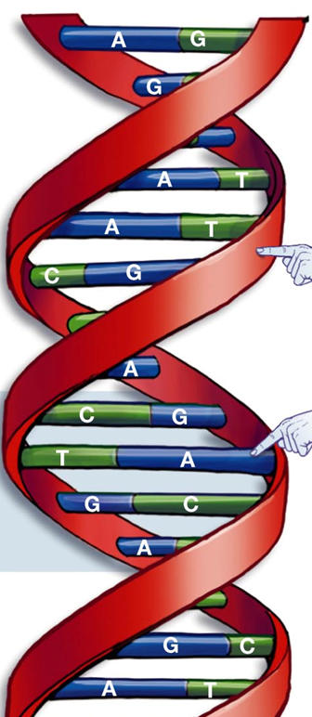
All cells contain instructions within them about how carry out all the necessary functions for life
These instructions are contained in the order of the nucleotides (sequence) of DNA
Remember:
DNA is made up of 2 intertwined strands, each composed of millions of nucleotides linked together by covalent bonds
The two strands are linked by hydrogen bonds between nucleotide bases

Slide 4
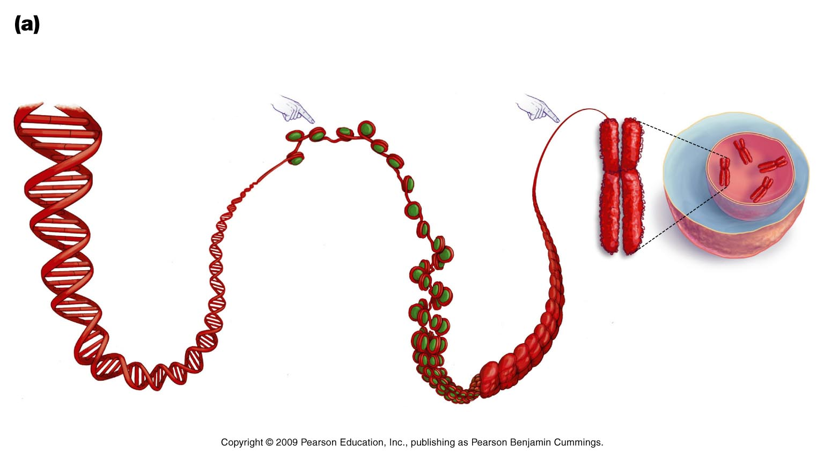
A single piece, or molecule, of DNA is called a chromosome
Our chromosomes are 50% DNA and 50% specialized proteins called histones
DNA wraps itself around histones in order to become very coiled and dense
DNA
histone
chromosome
Prokaryotes have no histones

Slide 5
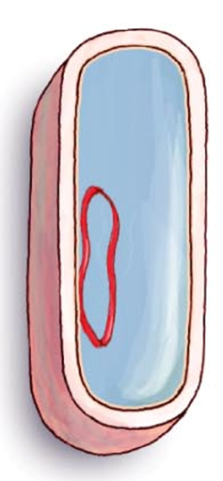
Remember:
In eukaryotic cells (protists, plants, fungi, animals) chromosomes are in multiple segments within the nucleus
In prokaryotic cells (bacteria and archaea) the DNA is contained in a chromosome that forms a single loop

Slide 6
All cells, except sex cells, contain a complete collection of all the genetic information (DNA) in an organism, which is called its genome
The human genome contains ~20,000 – 25,000 genes
This means that your cheek cell contains all the information needed to make bone, hemoglobin, milk, testosterone, insulin, hair, etc.
However, a cell only “reads” the instructions from its portion of the genome, so a cheek cell only uses the DNA needed for a cheek cell

Slide 7
Remember: Cellular Reproduction
Every cell comes from a another cell, which came before it
In order for life to continue, cells must create new cells by dividing
Multicellular organisms must replace cells that die or are worn out
In a human, it is estimated that about 25 million new cells are created each second (that’s more cells than all the people living in Texas)
All of the non-sex cells reproduce by mitosis (sex cells are different!)

Slide 8
What are Chromosomes?
In the cells of sexually reproducing organisms there are two versions of each chromosome; a maternal and a paternal version
These chromosome pairs are called homologues
Homologues contain copies of the same genes as each other, each with different possible variations
Thus, we inherit genes coding for both mom’s and dad’s eye color, hair color, dimpled chin, etc. and give them a fresh mix

Slide 9
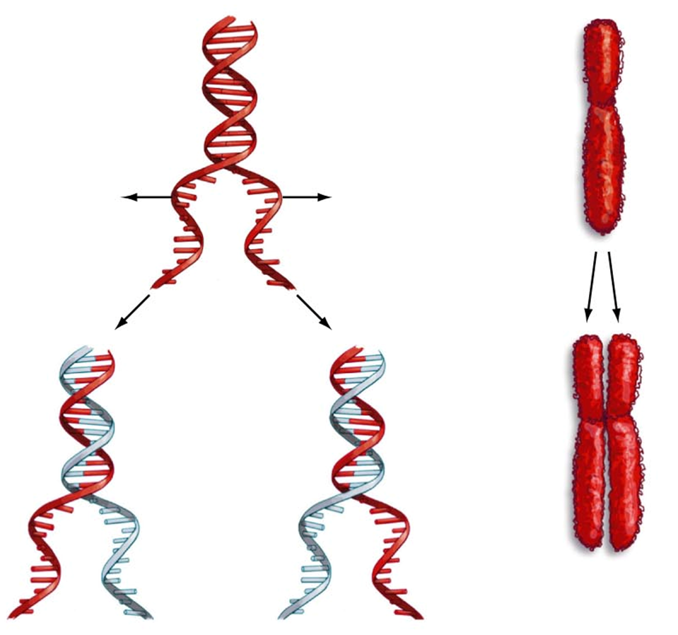
Exact copying and editing of mistakes in DNA is called Replication
Every time a cell divides it must copy its DNA
During DNA replication each of the two strands of DNA must be exactly duplicated
Each of the original two strands unwinds and acts as a template for two new strands
Once a chromosome is replicated, the two identical pieces are called sister chromatids
For humans, this happens 23 times in chromosomes we got from mom and 23 times in chromosomes we got from dad

Slide 10
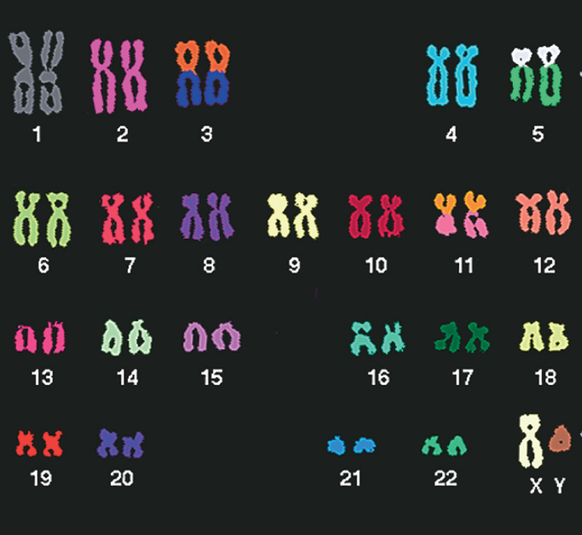
Human karyotype
A karyotype is a visual image of all chromosome homologues in a cell as viewed through a microscope.
Humans have 23 pairs of chromosomes (46 total), half of which came from each parent
Chromosome pairs are given a number based on their size (biggest to smallest)
The last chromosome pair are the sex chromosomes (X and Y)

Slide 11
We’ve said that double-stranded DNA is the genetic material of all living things on Earth….
In single-celled organisms the transfer to the next generation occurs by either binary fission (prokaryotes) or mitosis (eukaryotes).
Mitosis is also how we transfer DNA when we replace cells in the body.
The goal of these mechanisms is to transfer exact DNA copies.
So where does sexual reproduction come into this?
Are the processes and goals the same?

Slide 12
Sexual reproduction is the most common life cycle in multi-cellular eukaryotes: animals, fungi and plants.
Sexual reproduction does not occur in prokaryotes
Bacterial conjugation, transformation and transduction, may have been precursors to sexual reproduction in early eukaryotes
The purpose of sexual reproduction is to produce new genetic combinations in each new organism
This creates great genetic diversity, which is very good for the population but can be rough on the individual!

Slide 13
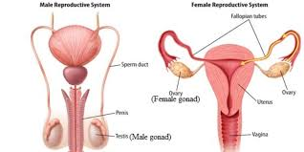
In sexual reproduction, each parent makes a gamete (sperm or egg) with only one set of chromosomes (haploid cell) vs. a typical diploid cell
This is accomplished by a different kind of cell division, meiosis, which only occurs in the cells of the parents gonads
In animals, the female gonad (ovary) and male gonad (testes) have stem cells capable of meiosis

Slide 14
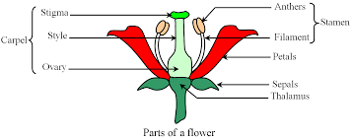
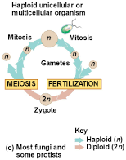
In plants, the female gonad is the ovary of the carpel, while the anthers are the male gonad. Many can self-fertilize.
In fungi and some protists, they live most of their lives in the haploid state.
Two fully functional cells must then fuse into a diploid cell just long enough to undergo meiosis.

Slide 15
Fusion of two haploid gametes is called fertilization, and produces a new organism with the full amount of genetic material
For simplicity, one set of chromosomes is given the abbreviation “n”
Since diploid cells have two sets of chromosomes, they are abbreviated 2n, while haploid cells are abbreviated 1n
In humans…
Diploid cells have 46 chromosomes (23 pairs, or 2 sets)
Haploid sperm and egg cells have 23 chromosomes
These are the only haploid cells in us!

Slide 16
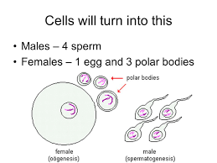
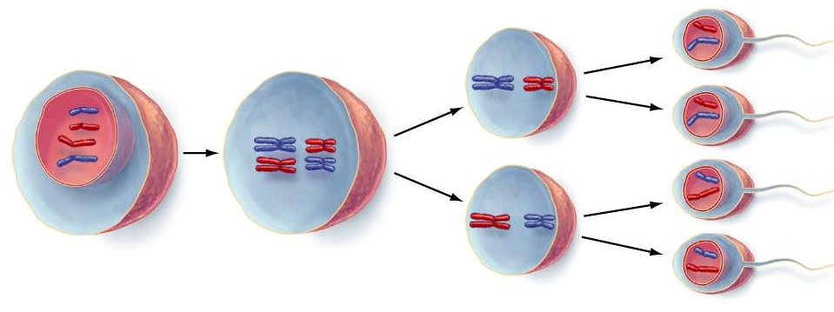
What is meiosis?
Specialized double cell division that produces 4 copies of every chromosome
Four daughter cells are produced, each with 1 copy of each chromosome
In some animals ¾ of the chromosomes are discarded as polar bodies by the egg
Diploid (2n)
Haploid (1n)

Slide 17
Meiosis can create 4 haploid cells because there are two cell divisions after only a single DNA replication

Slide 18
A critical advantage of sexual reproduction and meiosis is to “scramble” the DNA so that each daughter cell is genetically different.
Genetic diversity allows a population of organisms to be able to adapt to changes in their environment
Makes sure that there are always some individuals that can handle whatever comes!

Slide 19
Independent Assortment of Chromosomes during Meiosis in Sexually Reproducing Organisms
In the diploid cells undergoing meiosis, matching pairs of chromosomes (homologues) from mom and dad orient randomly at metaphase I of meiosis
In independent assortment, each pair of maternal and paternal chromosomes sorts into daughter cells independently of the other pairs
The number of combinations possible when chromosomes assort independently into gametes is 2^{n}, where n is the haploid number
For humans (n = 23), there are more than 8 million (2²³) possible combinations of chromosomes in every sperm and egg!

Slide 20
Random Fertilization in Sexually Reproducing Organisms
Random fertilization adds to genetic variation because any sperm can fuse with any unfertilized egg
The fusion of two gametes (each with 8.4 million possible chromosome combinations) produces a zygote with any of about 70 trillion diploid combinations

Slide 21
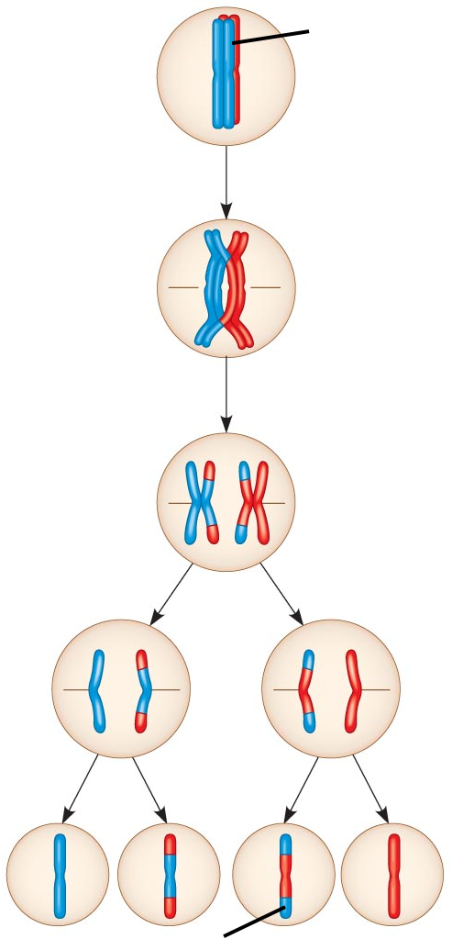
Crossing Over makes it even more variable
Mom’s in red
Dad’s in blue
Crossing over produces recombinant chromosomes, which combine genes inherited from each parent
Crossing over begins very early in prophase I of meiosis
In crossing over, homologous portions of mom and dad’s chromosomes trade places
Crossing over contributes to genetic variation by combining DNA from two parents into a single chromosome
recombinant chromosomes

Slide 22
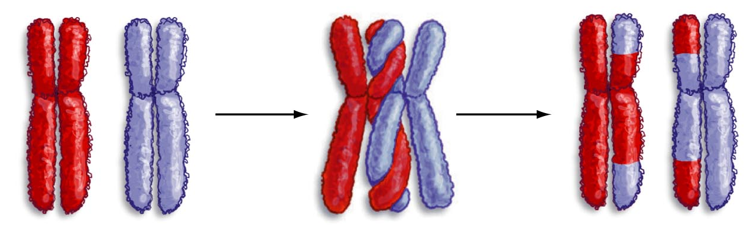
After crossing over occurs, there are no longer exclusively “mom” and “dad” chromosomes
Since the sister chromatids are no longer identical, independent assortment also occurs in metaphase II
The potential combinations are literally endless… every time!

Slide 23
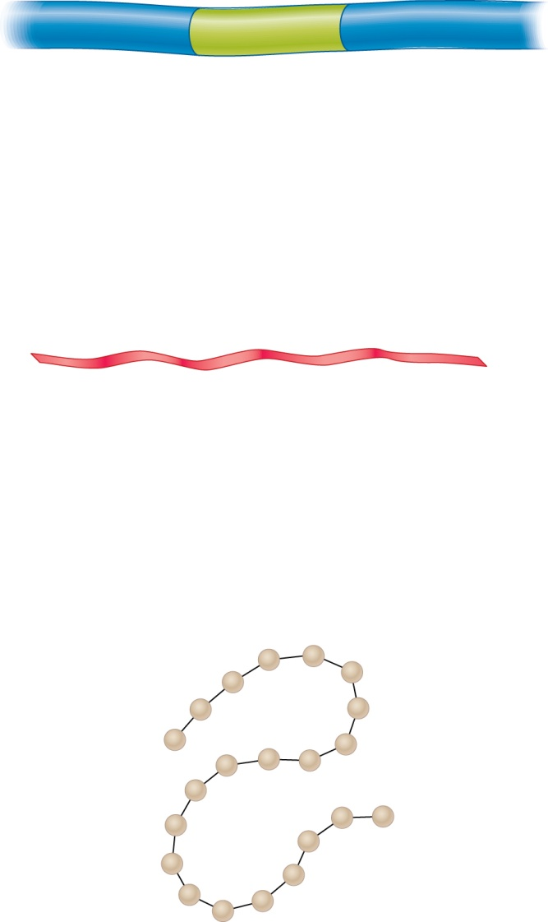
Flow of Genetic Information
DNA
(nucleic acid)
DNA encodes the instructions for the activities of all living things
DNA serves as a template to make new RNA molecules in the nucleus, mitochondrion and chloroplast
RNA leaves the organelles and carries the instructions received from the DNA into the cytosol
RNA serves as the template to make new protein molecules on cytosolic ribosomes
RNA has a much more extensive role in Translation!
Gene
Transcription
RNA
(nucleic acid)
Translation
Proteins
(amino acids)

Slide 24
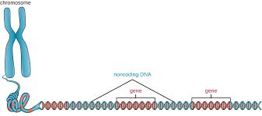
DNA is the Keeper of Genetic Information
Genetic information – contained in the order of the bases
One molecule of DNA contains multiple genes
Genes – segments of DNA with genetic information to make a functional product
Gene Expression – building the gene product through transcription, translation and post-translational processing

Slide 25
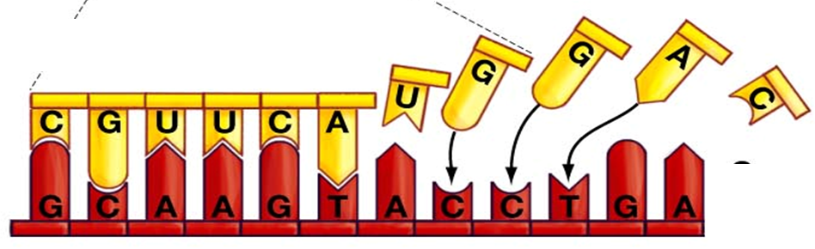
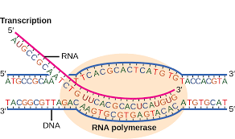
Transcription – an enzyme-facilitated process that builds an RNA molecule using a DNA molecule as a sequence template
DNA and RNA are two types of nucleic acid
Transcription is writing in the same “language”
RNA Polymerase does it all
Unwinds and rewinds DNA double strand
Identifies the matching RNA nucleotide
Makes the dehydration covalent bond

Slide 26
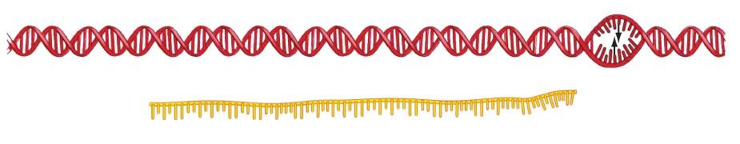
The End of Transcription
The DNA sequence contains code that tells RNA-polymerase that it has reached the end of the gene
The RNA breaks free and RNA polymerase falls off of the DNA
3’
5’
RNA
RNA-polymerase
falls off the DNA

Slide 27
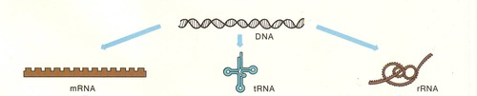
What kinds of RNA do we make during Transcription?
There are three main types of RNA molecules, each with different functions in the process of translation
There are many other types of active RNA molecules and we will cover them when they come up this semester!
Messenger RNA (mRNA)
carries the sequence code to make a protein
Transfer RNA (tRNA)
Works to match mRNA sequence to amino acids
Ribosomal RNA (rRNA)
builds the ribosomal machines that form amino acid bonds

Slide 28
Translation: Making Proteins
Translation builds proteins using mRNA molecules as a template
“one language to another”
There must be communications between two types of macromolecules:
RNA – sequence made of 4 types of ribonucleotides
Proteins – sequence made of 20 types of amino acids

Slide 29
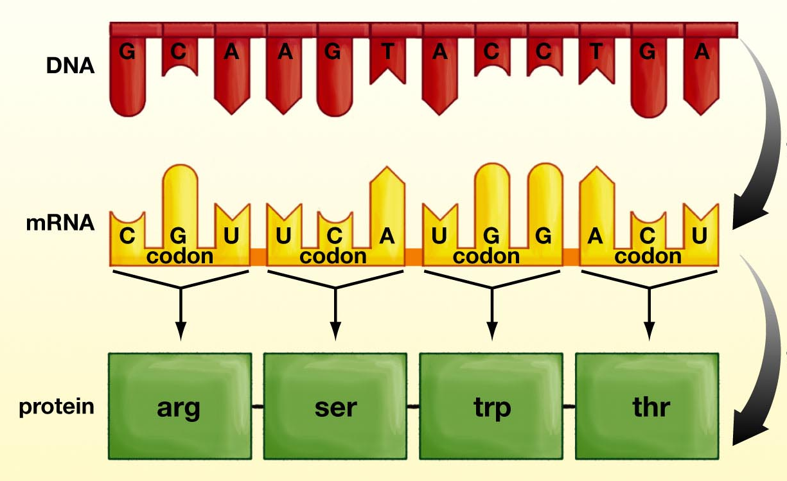
Reading the Genetic Code
Codon – set of 3 RNA nucleotides that code for one amino acid
A codon is like the “words” of the english language
If there are 4 different RNA nucleotides (AUCG) and you can only arrange 3 at the time, then you have 4³ possible combinations = 64 available codons
Each of the 64 different codons “code” for one specific amino acid
Transcription
Translation

Slide 30
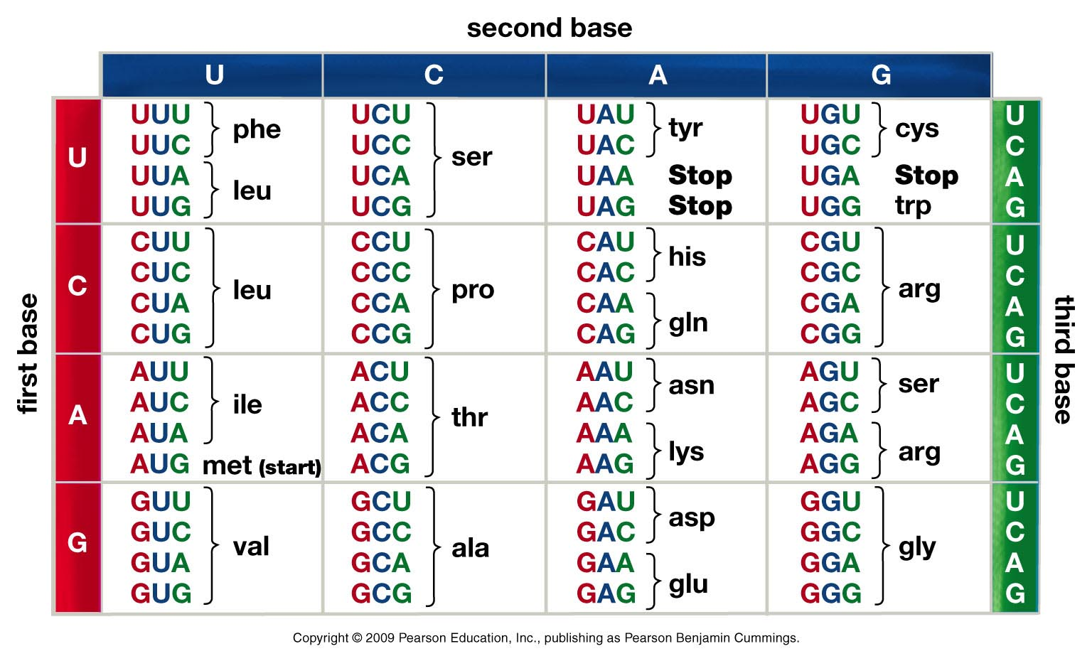
Reading the Genetic Code
This Code works for every cell, from eukaryotes to prokaryotes.
Very strong evidence for evolution from a common ancestor.

Slide 31
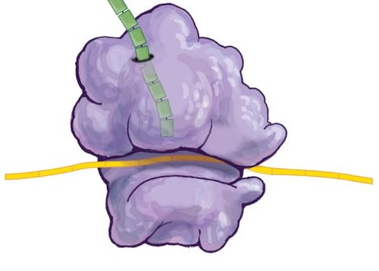
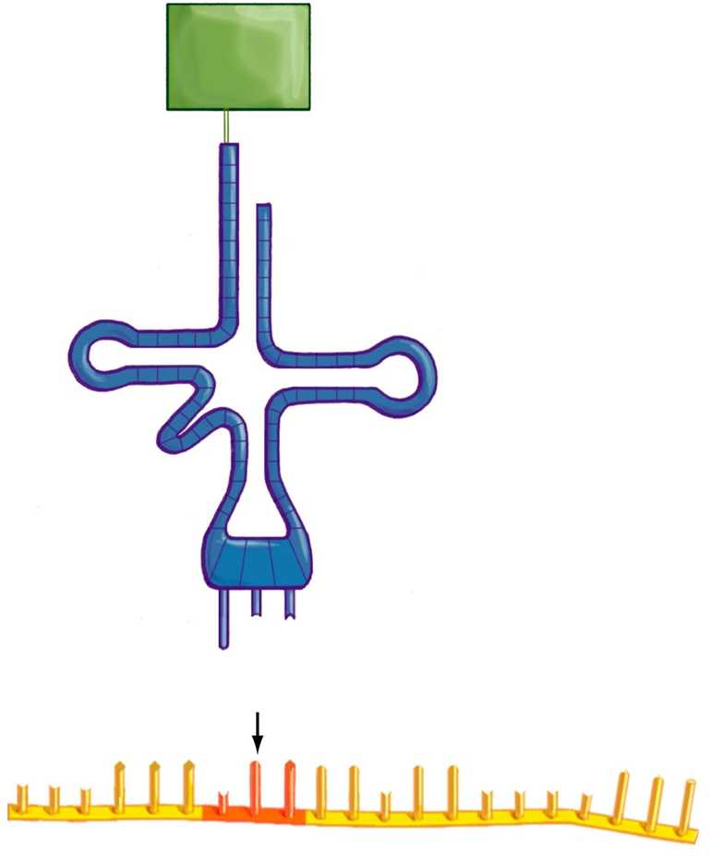
The Role of RNA in Translation
Ribosomal RNA (rRNA) – enzymatically makes peptide bonds between a.a.
Messenger RNA (mRNA) – transcribed from DNA, sent out through pores
Transfer RNA (tRNA) – read mRNA and link appropriate amino acids to codons
Ribosomes are combination of rRNA and protein
tRNA binds to the a.a. that matches its codon.
The ribosome grabs the next tRNA in line and joins the a.a.
Recognize the lead end of mRNA

Slide 32
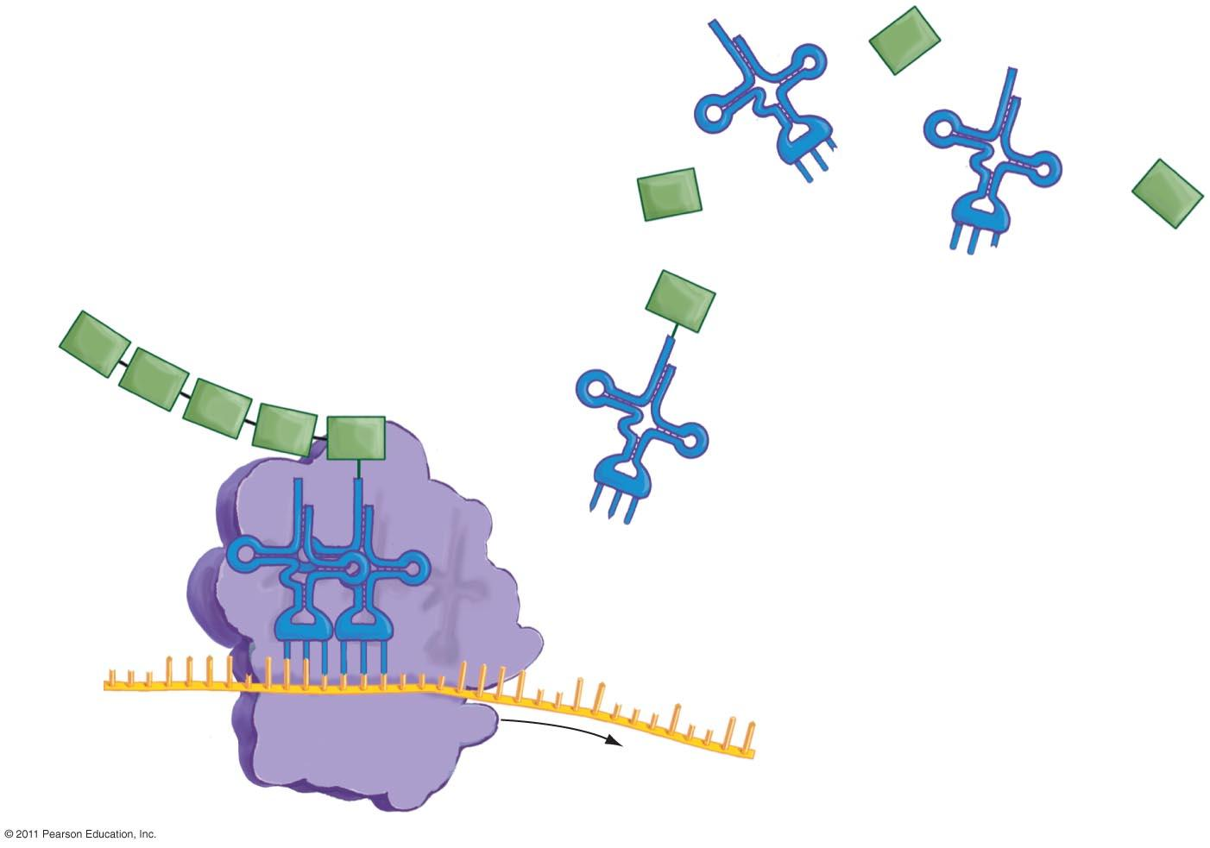
tRNA’s bring a.a. to the ribosomes, which “read” mRNA
met
1. tRNA and amino acids
float freely in cytoplasm.
asp
leu
leu
leu
glu
2. tRNA binds to the amino acid that matches its codon and transfers it to the ribosome.
thr
4. A polypeptide
chain is
produced.
gly
phe
3. tRNA links to the
appropriate mRNA
codon at the ribosome.
mRNA
ribosome

Slide 33
Gene Expression in Cells
Total number of genes:
E. coli (bacteria; prokaryotic cell) – 4,377 genes
Humans (eukaryotic cells) – 20,500 genes
Rice (eukaryotic cells) – 28,256
Do you think ALL these genes are expressed ALL the time?
What would happen if they were ON all the time?

Slide 34
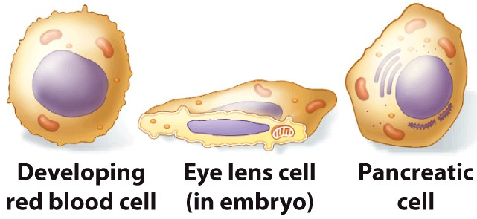
Regulation of Gene Expression
Hemoglobin
Crystallin
Insulin
Adult humans have >200 cell types with very different functions
We have ~20,000 genes and each cell expresses only ~5,000 at any one time
Some genes are common to all of our cells, while others are unique to just one
DNA in each gene tells which cells to express it and when

Slide 35
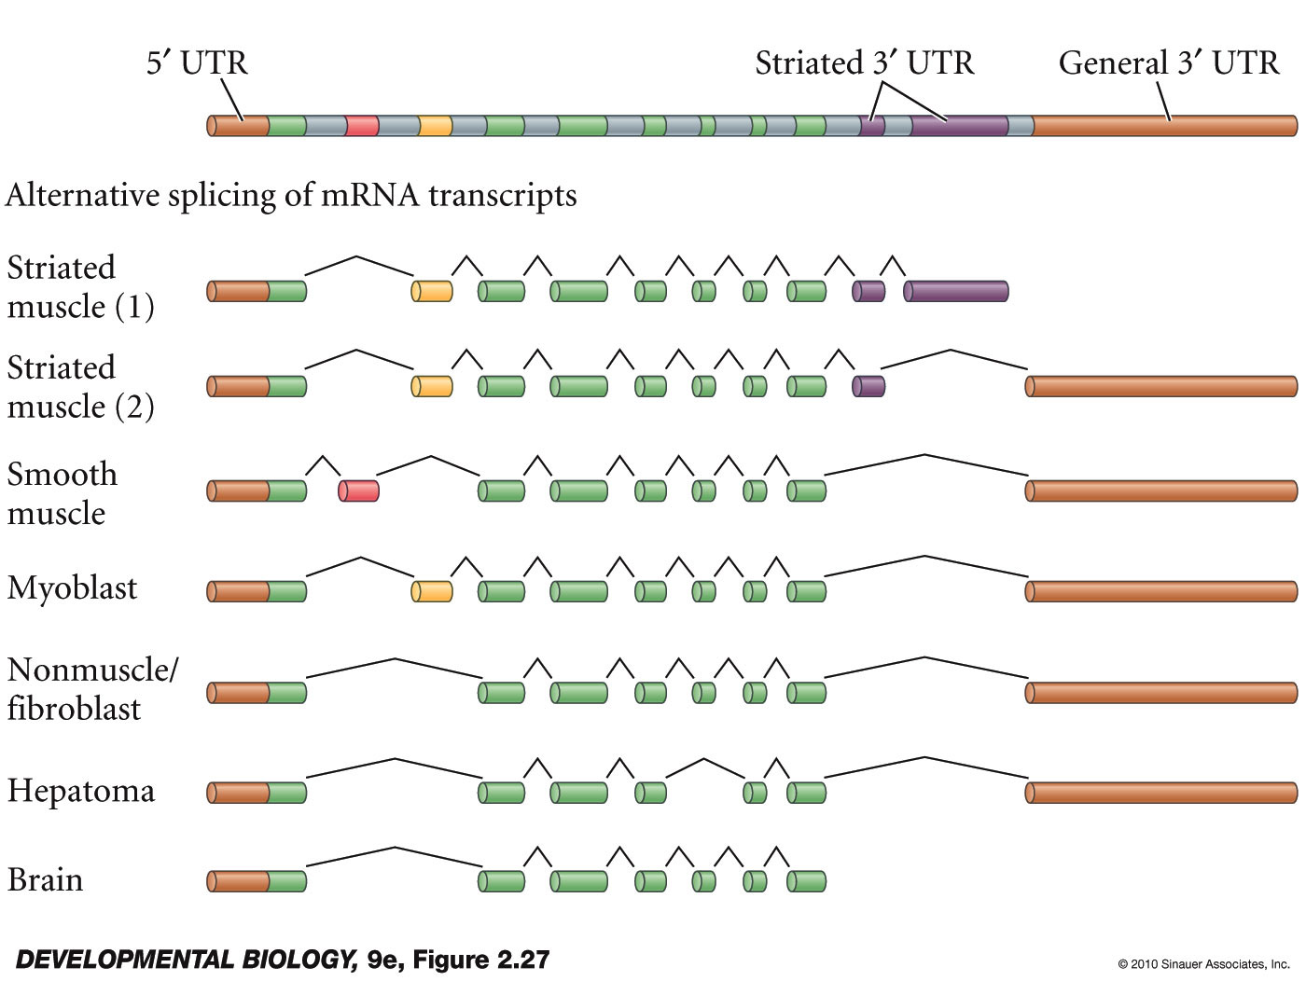
The information in DNA is very complex and allows us to form protein families from a single gene
rat α-tropomyosin protein family
Notes:
DevBio9e-Fig-02-27-0.jpg

Slide 36
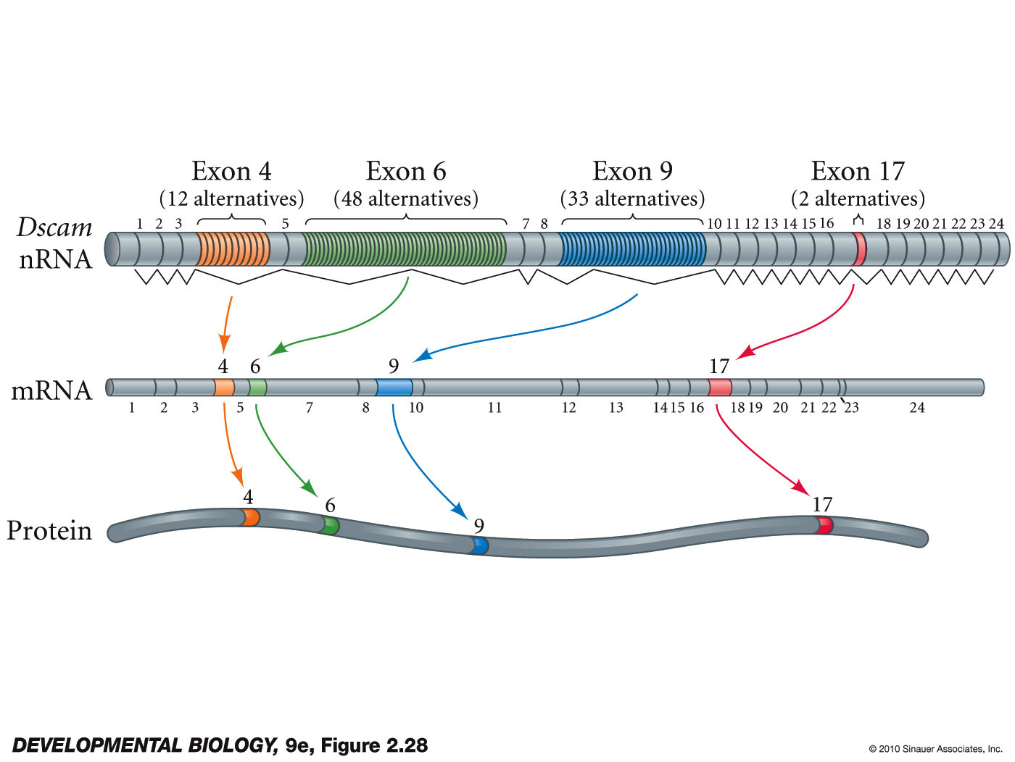
The Dscam gene of Drosophila is the current champion. It can produce 38,016 potential different proteins.
More than 30,000 of the variants have been observed from the embryo to the adult
The proteome in most eukaryotes dwarfs the genome in complexity!
Notes:
DevBio9e-Fig-02-28-0.jpg

